Slide 1
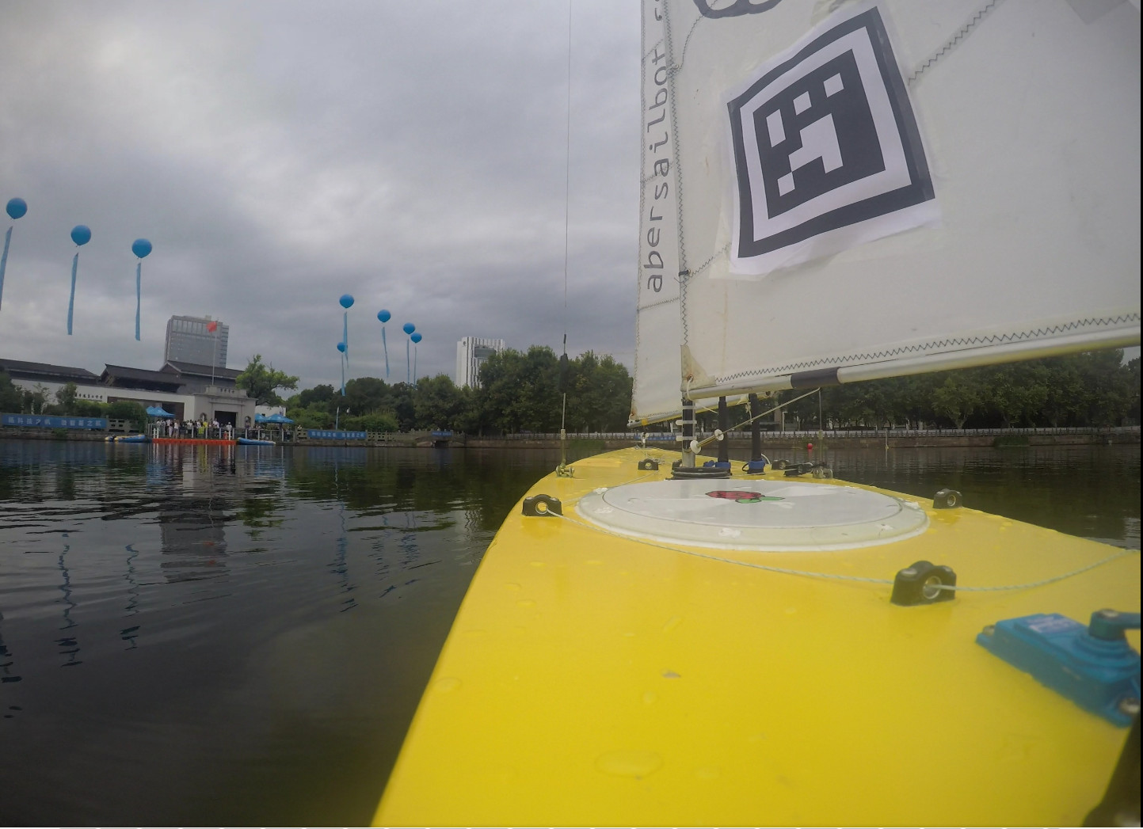

Notes:
---Lizzie---
Introduction

Slide 2
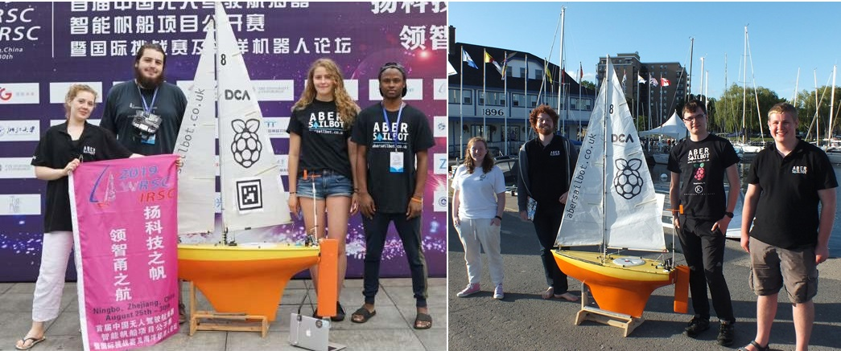



The Team
fb.com/abersailbot @abersailbot sailbot@aber.ac.uk
Notes:
We are AberSailbot!
Student led
Few members
Want more to join

Slide 3
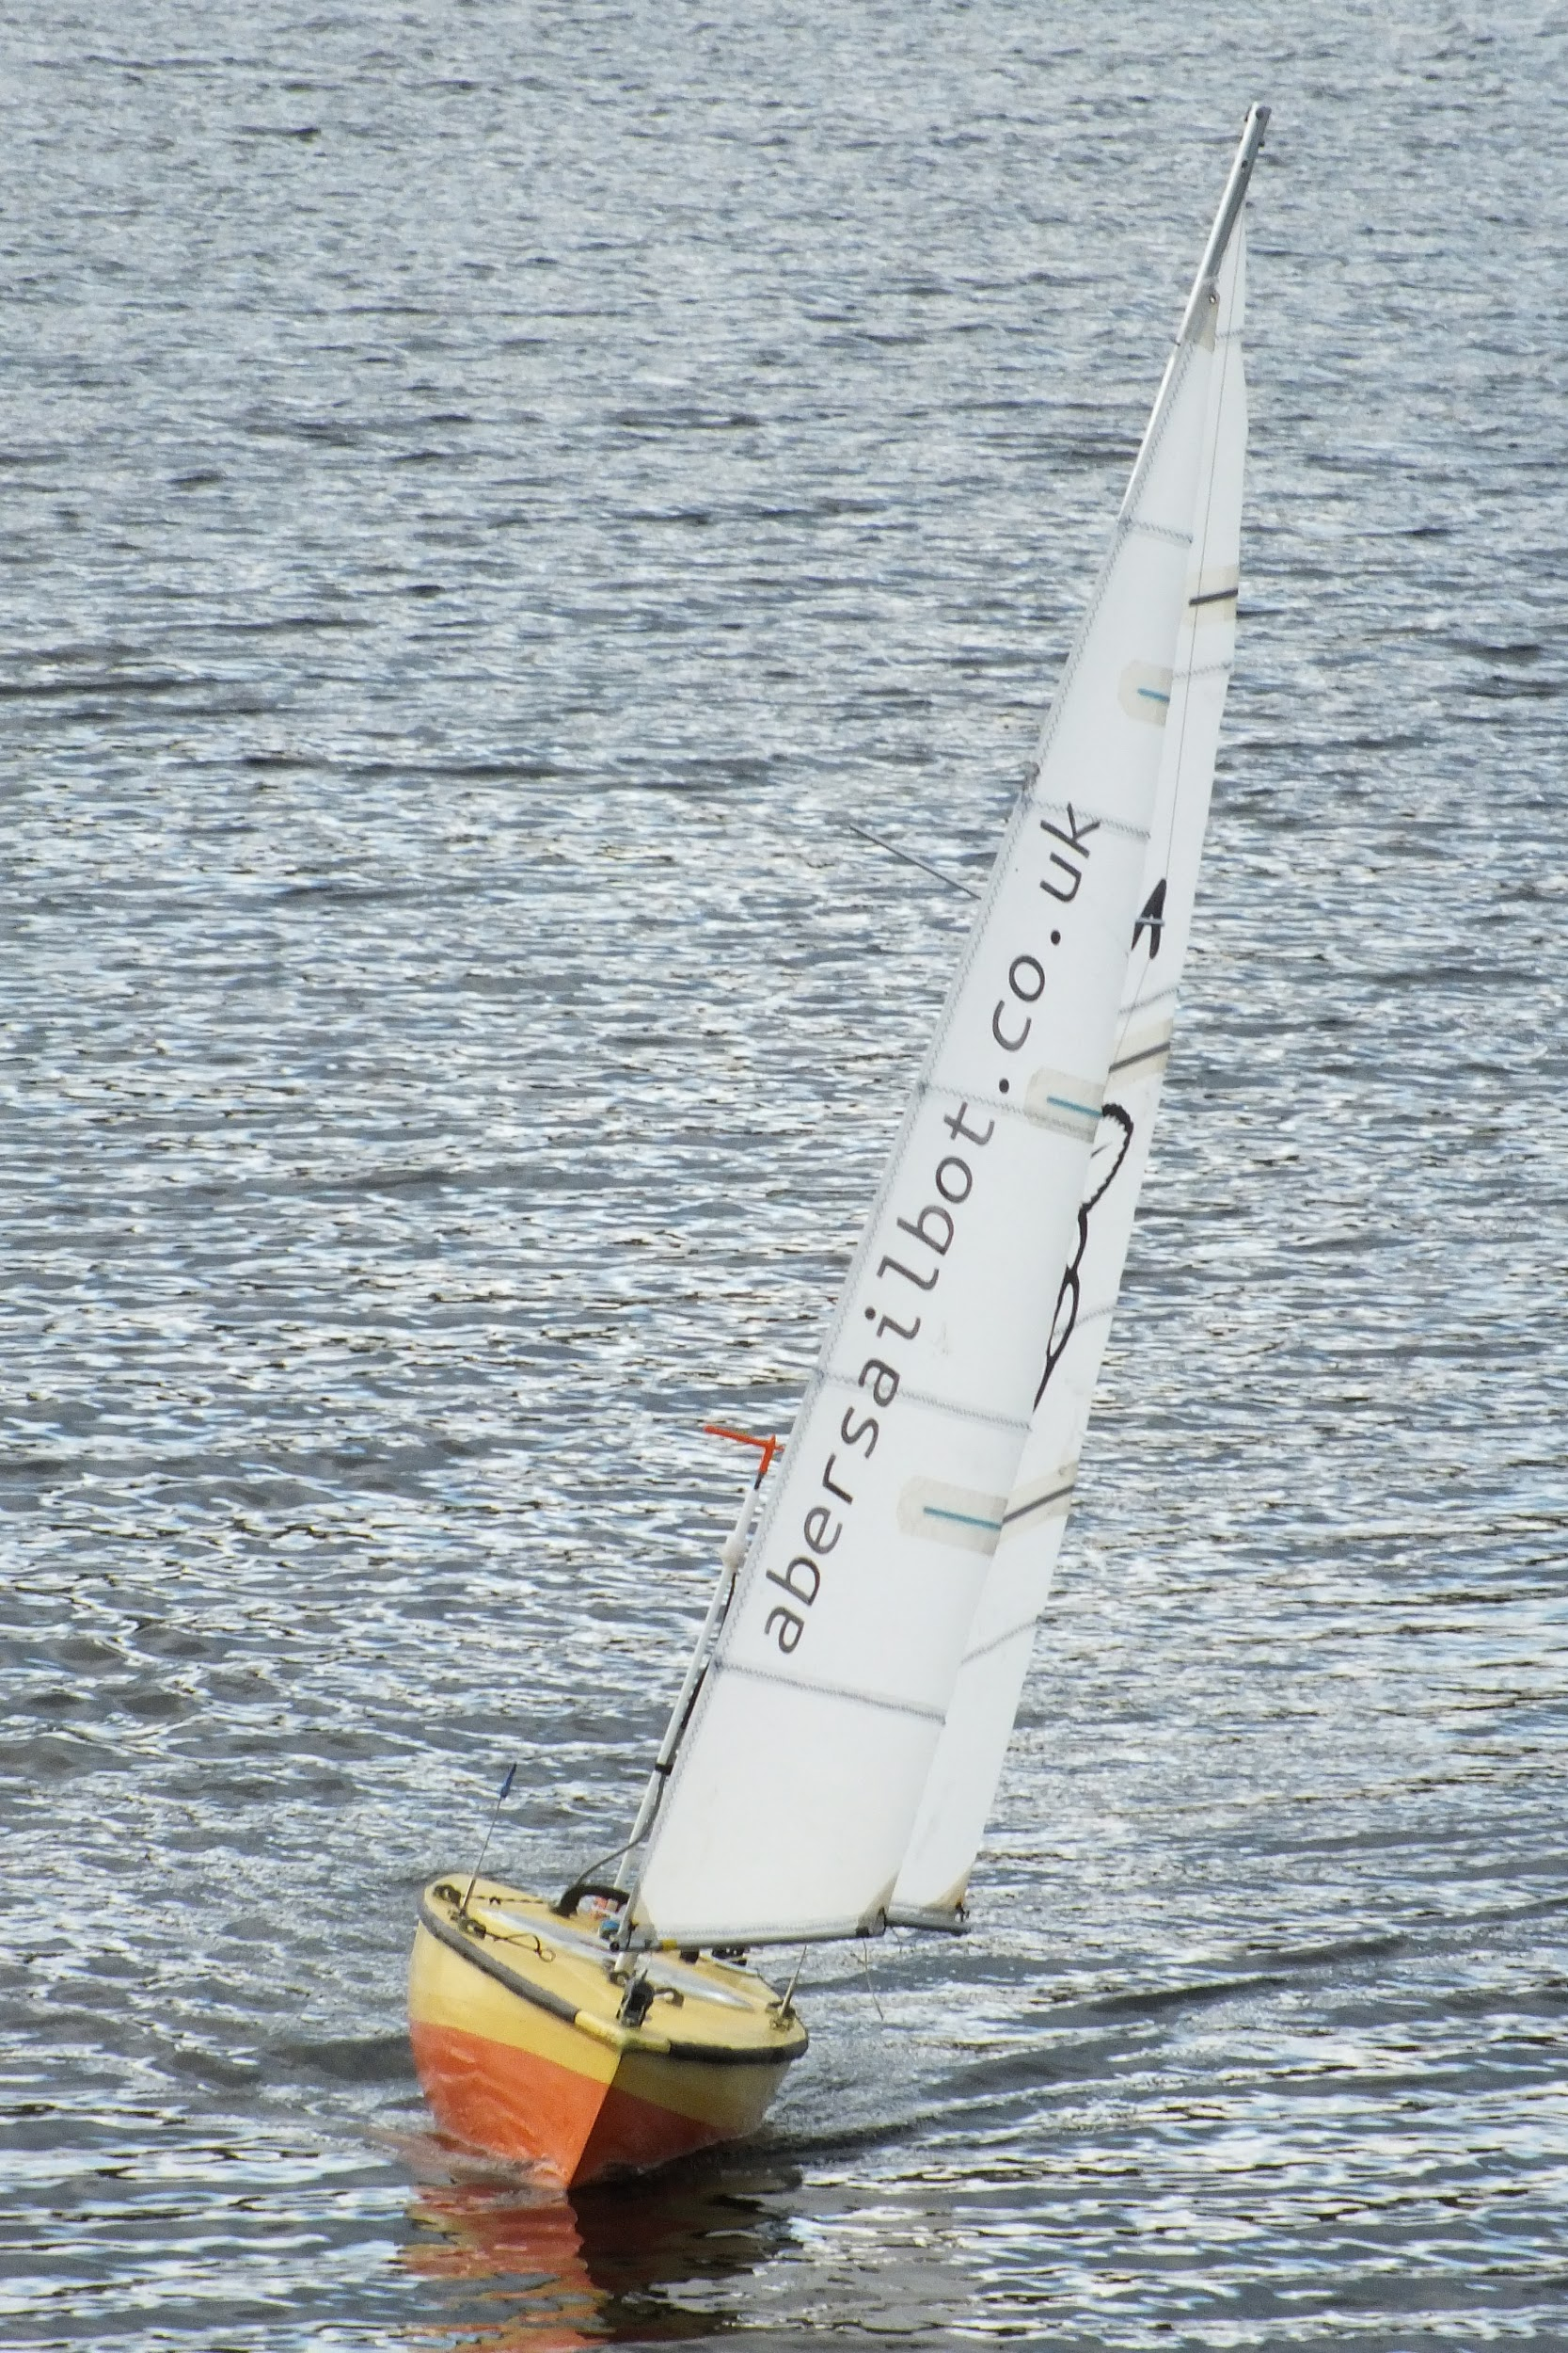
What do we do?
Build Autonomous Robotic Sailing Boats
Write code
Compete
fb.com/abersailbot @abersailbot sailbot@aber.ac.uk
Notes:
Robotic Boats
RC and Sail Themselves
Code (boatd etc)
Competitions
Microtransat
Not alone - community of people

Slide 4
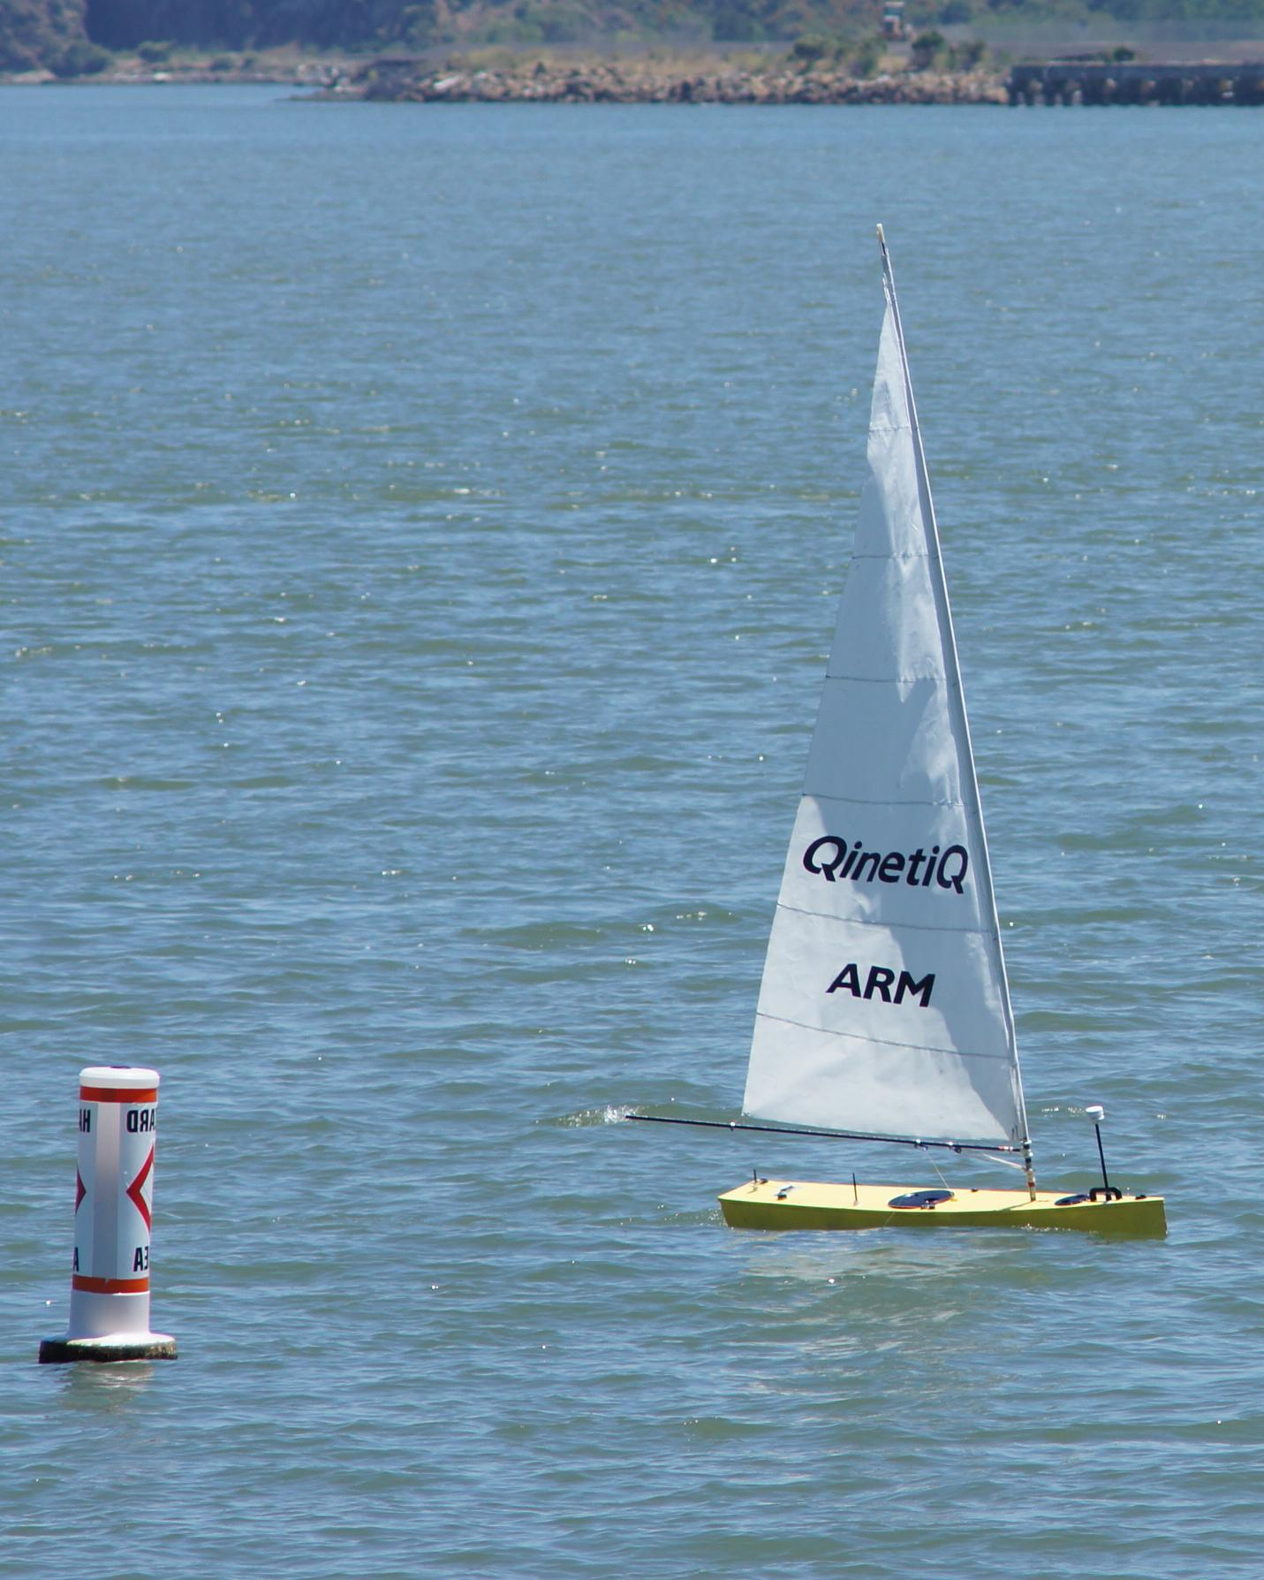
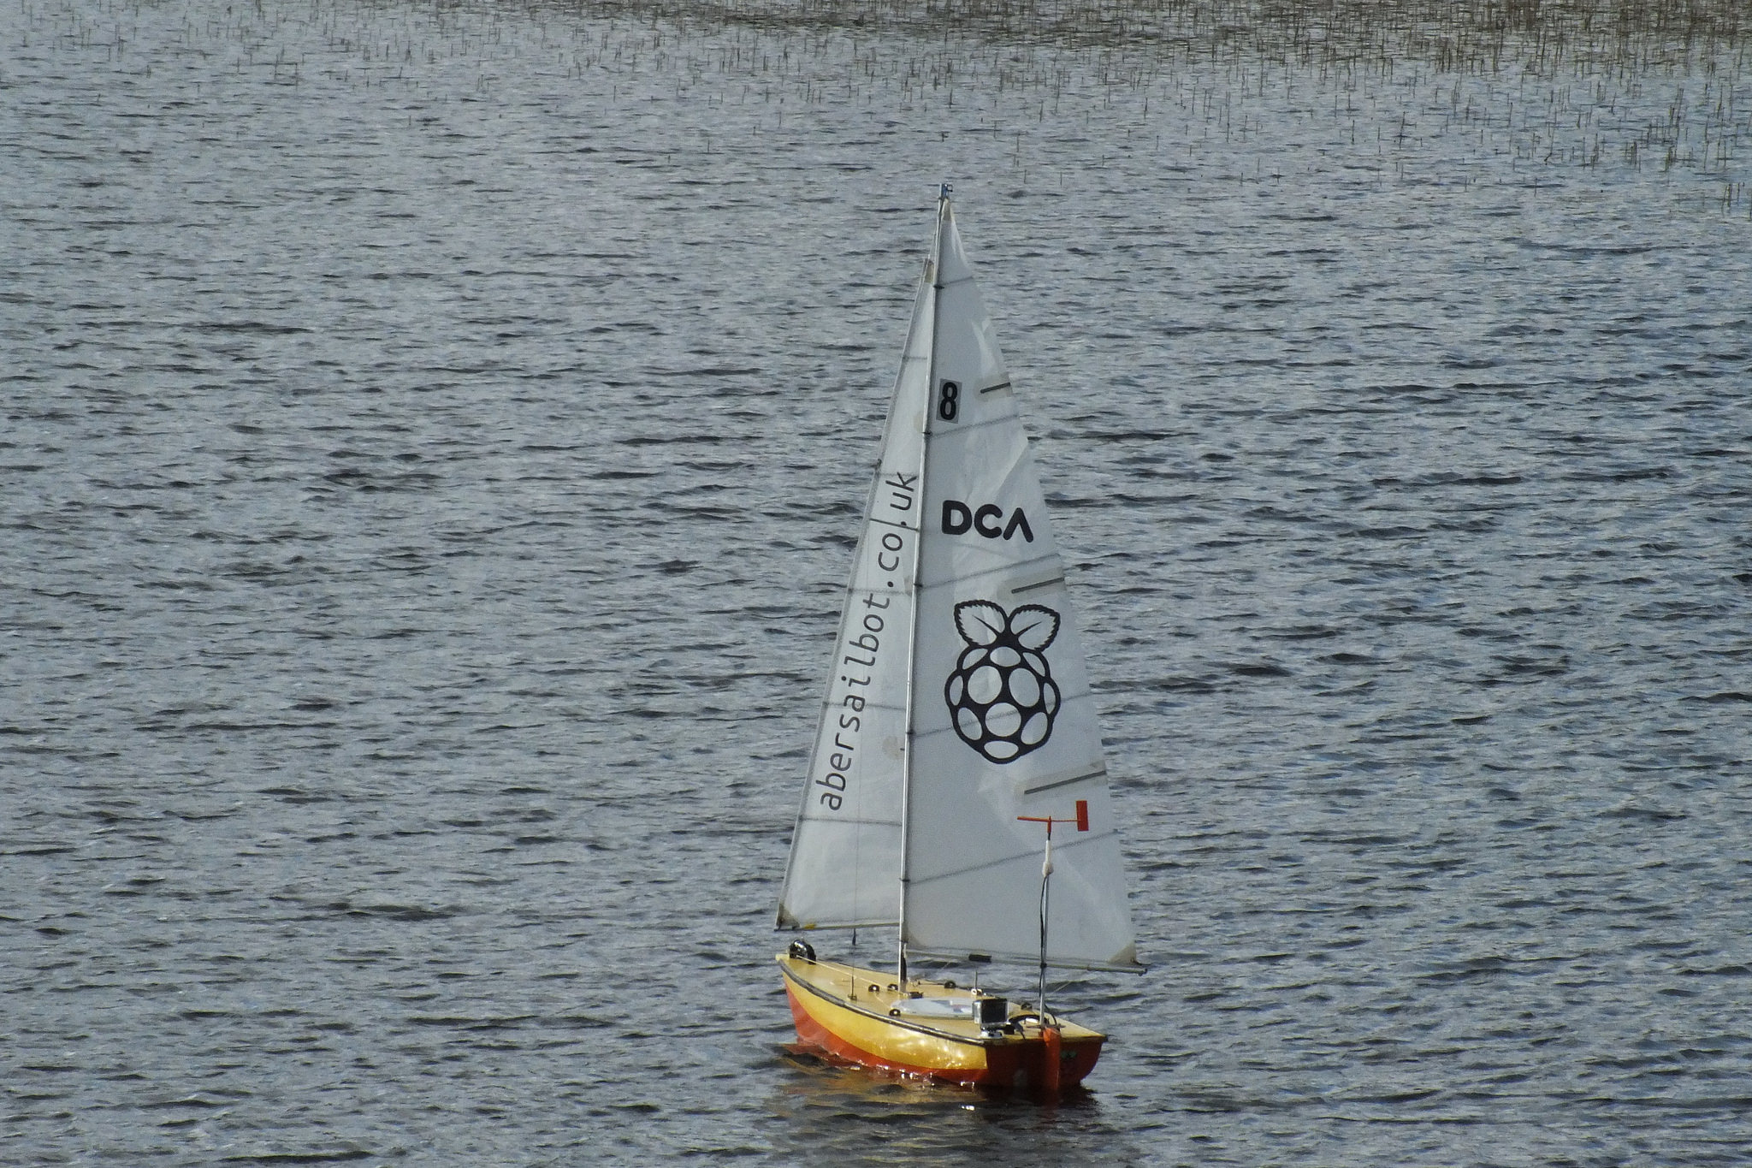
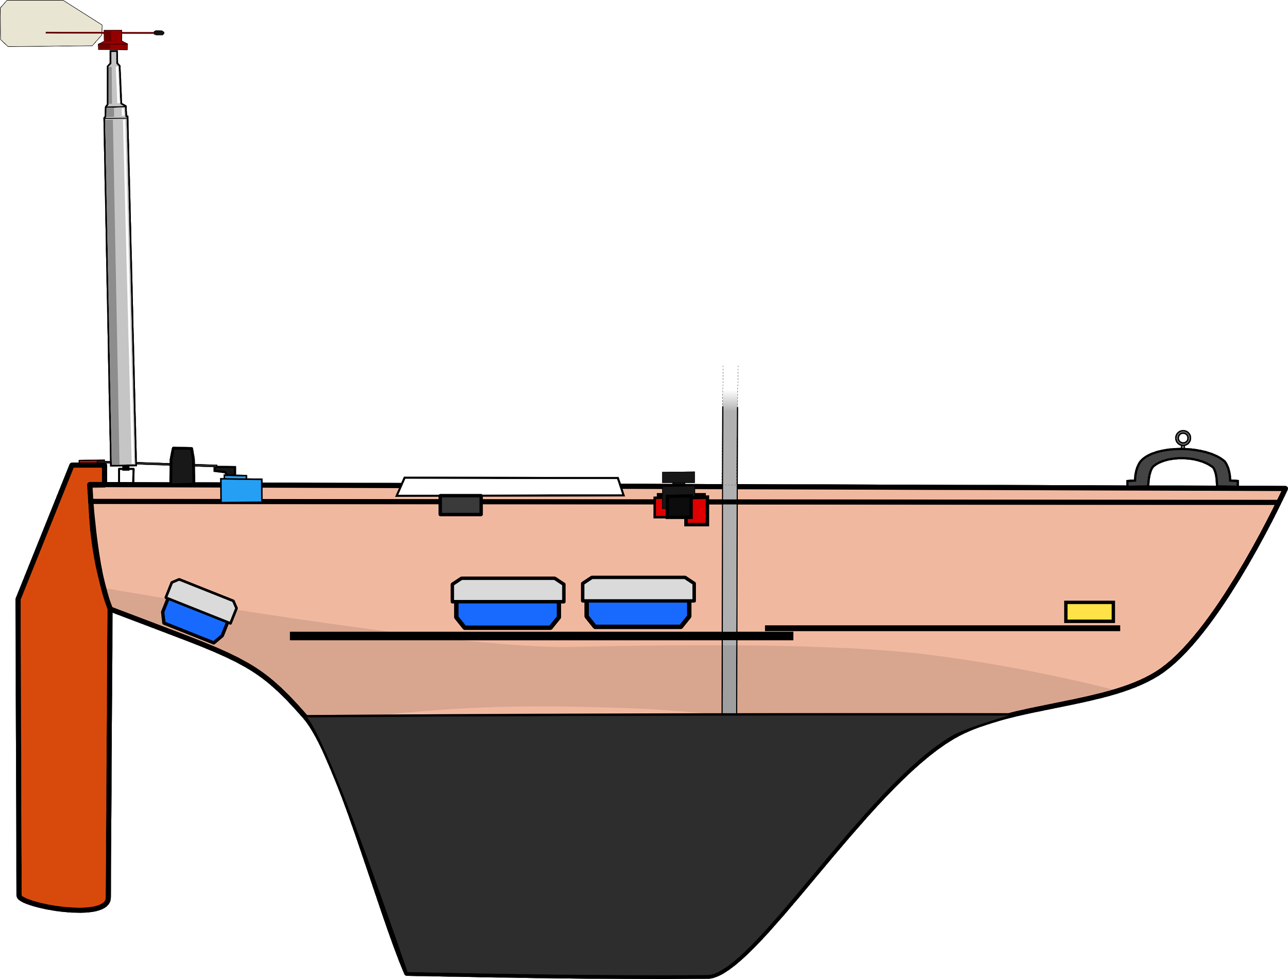
The Boats
Dewi’r Ddraig
Kitty
fb.com/abersailbot @abersailbot sailbot@aber.ac.uk
Notes:
Dewi’r Ddraig
Facts
Main and Jib
Maxi-MOOP hull - Paul Miller
1.2M, not the fastest, strong wind
Stable & reliable
New
Wind Sensor - dept design (rotary encoder)
Handle
Storm Sails
Electronics…
We have a simulator...
Kitty
Still work to be done
Needs new sail
Boat much larger
Detachable keel

Slide 5


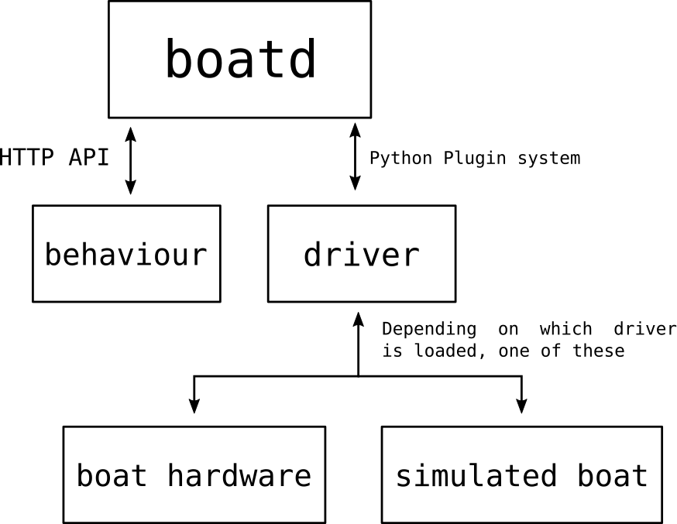
Software
Robotic Sailing Boat Daemon
Independent behaviours
Boat specific drivers
boatd
https://github.com/abersailbot
fb.com/abersailbot @abersailbot sailbot@aber.ac.uk
Notes:
---TOM---
Boat Daemon
Open Source
Run boat control behaviour (any language)
Talking to boat via driver
Functions: Great Circle

Slide 6
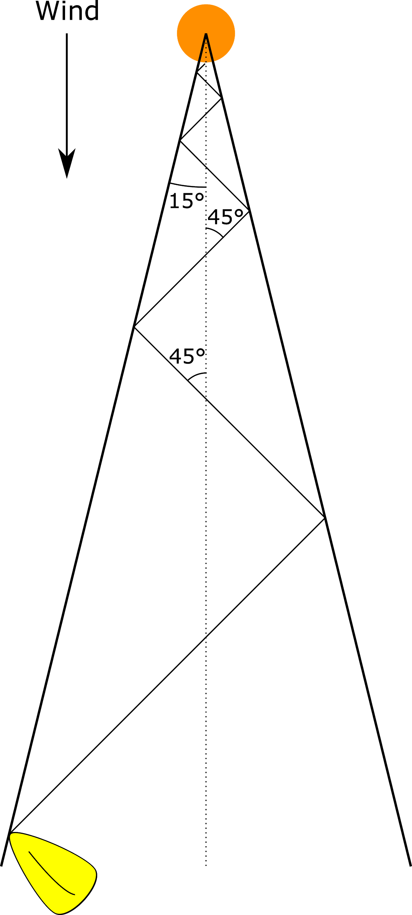
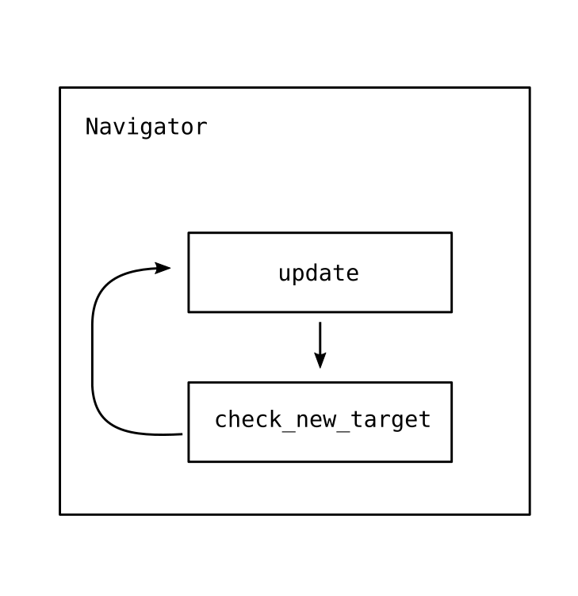
Behaviour
fb.com/abersailbot @abersailbot sailbot@aber.ac.uk
Notes:
Beating:
What it is
Why
Angle - wind from boat - check if >15*
Sail 45* to wind
Navigator
Speak to boatd
Load behaviour - station keep etc.

Slide 7
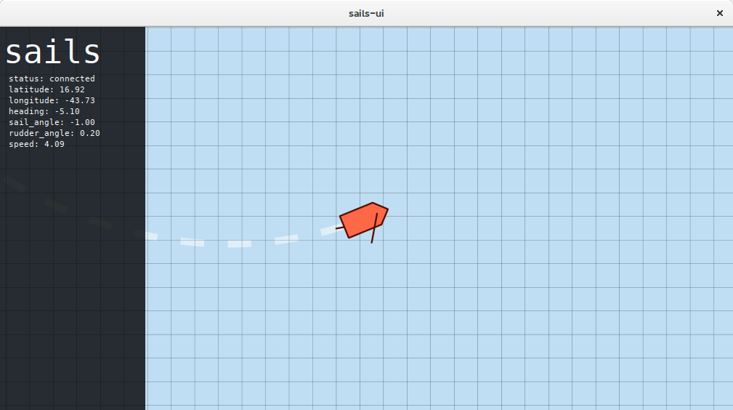
Simulation
https://github.com/sails-simulator
fb.com/abersailbot @abersailbot sailbot@aber.ac.uk
Notes:
sailsd
Louis Taylor - now left
Written in C
Simulates sailing physics
Run with boatd
JSON over TCP Socket

Slide 8
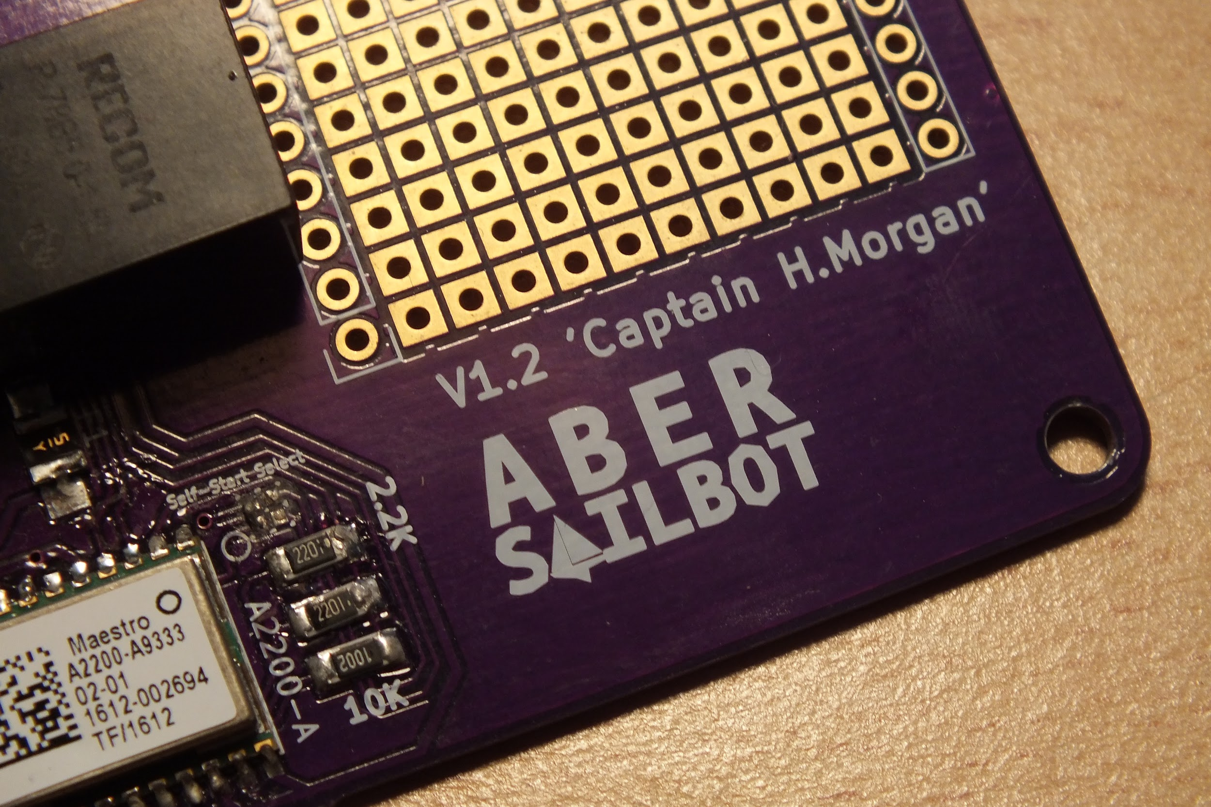
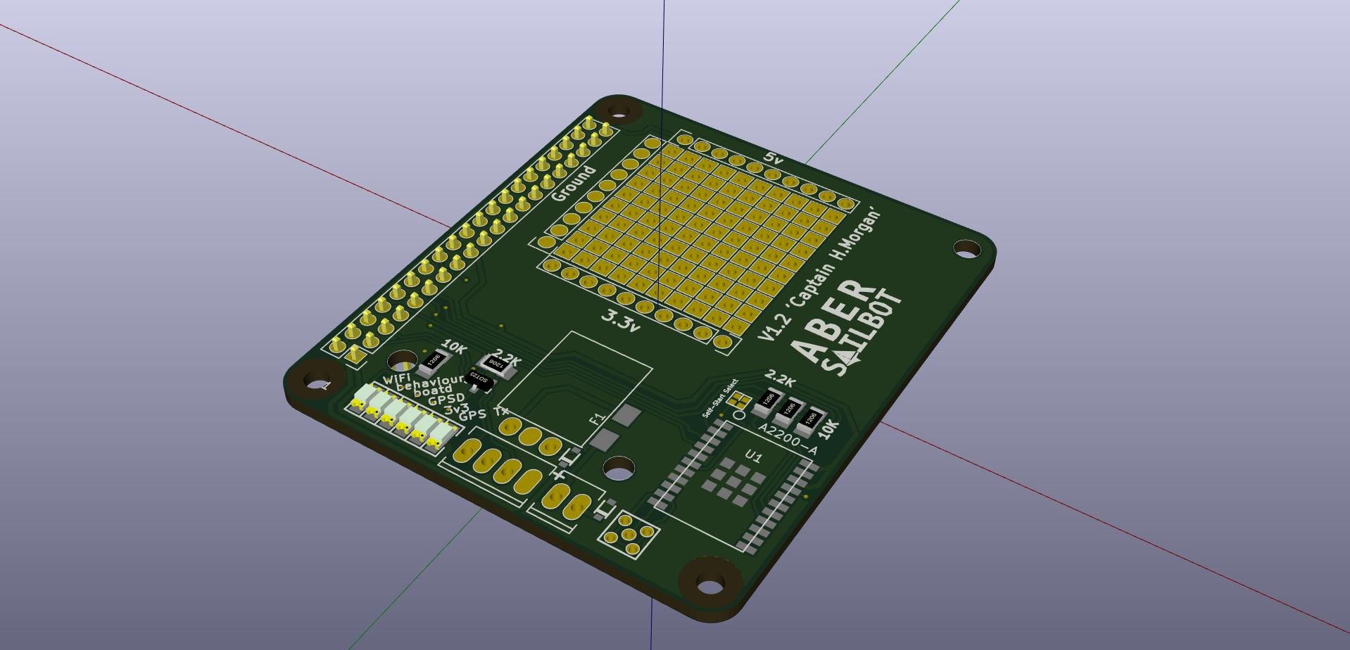
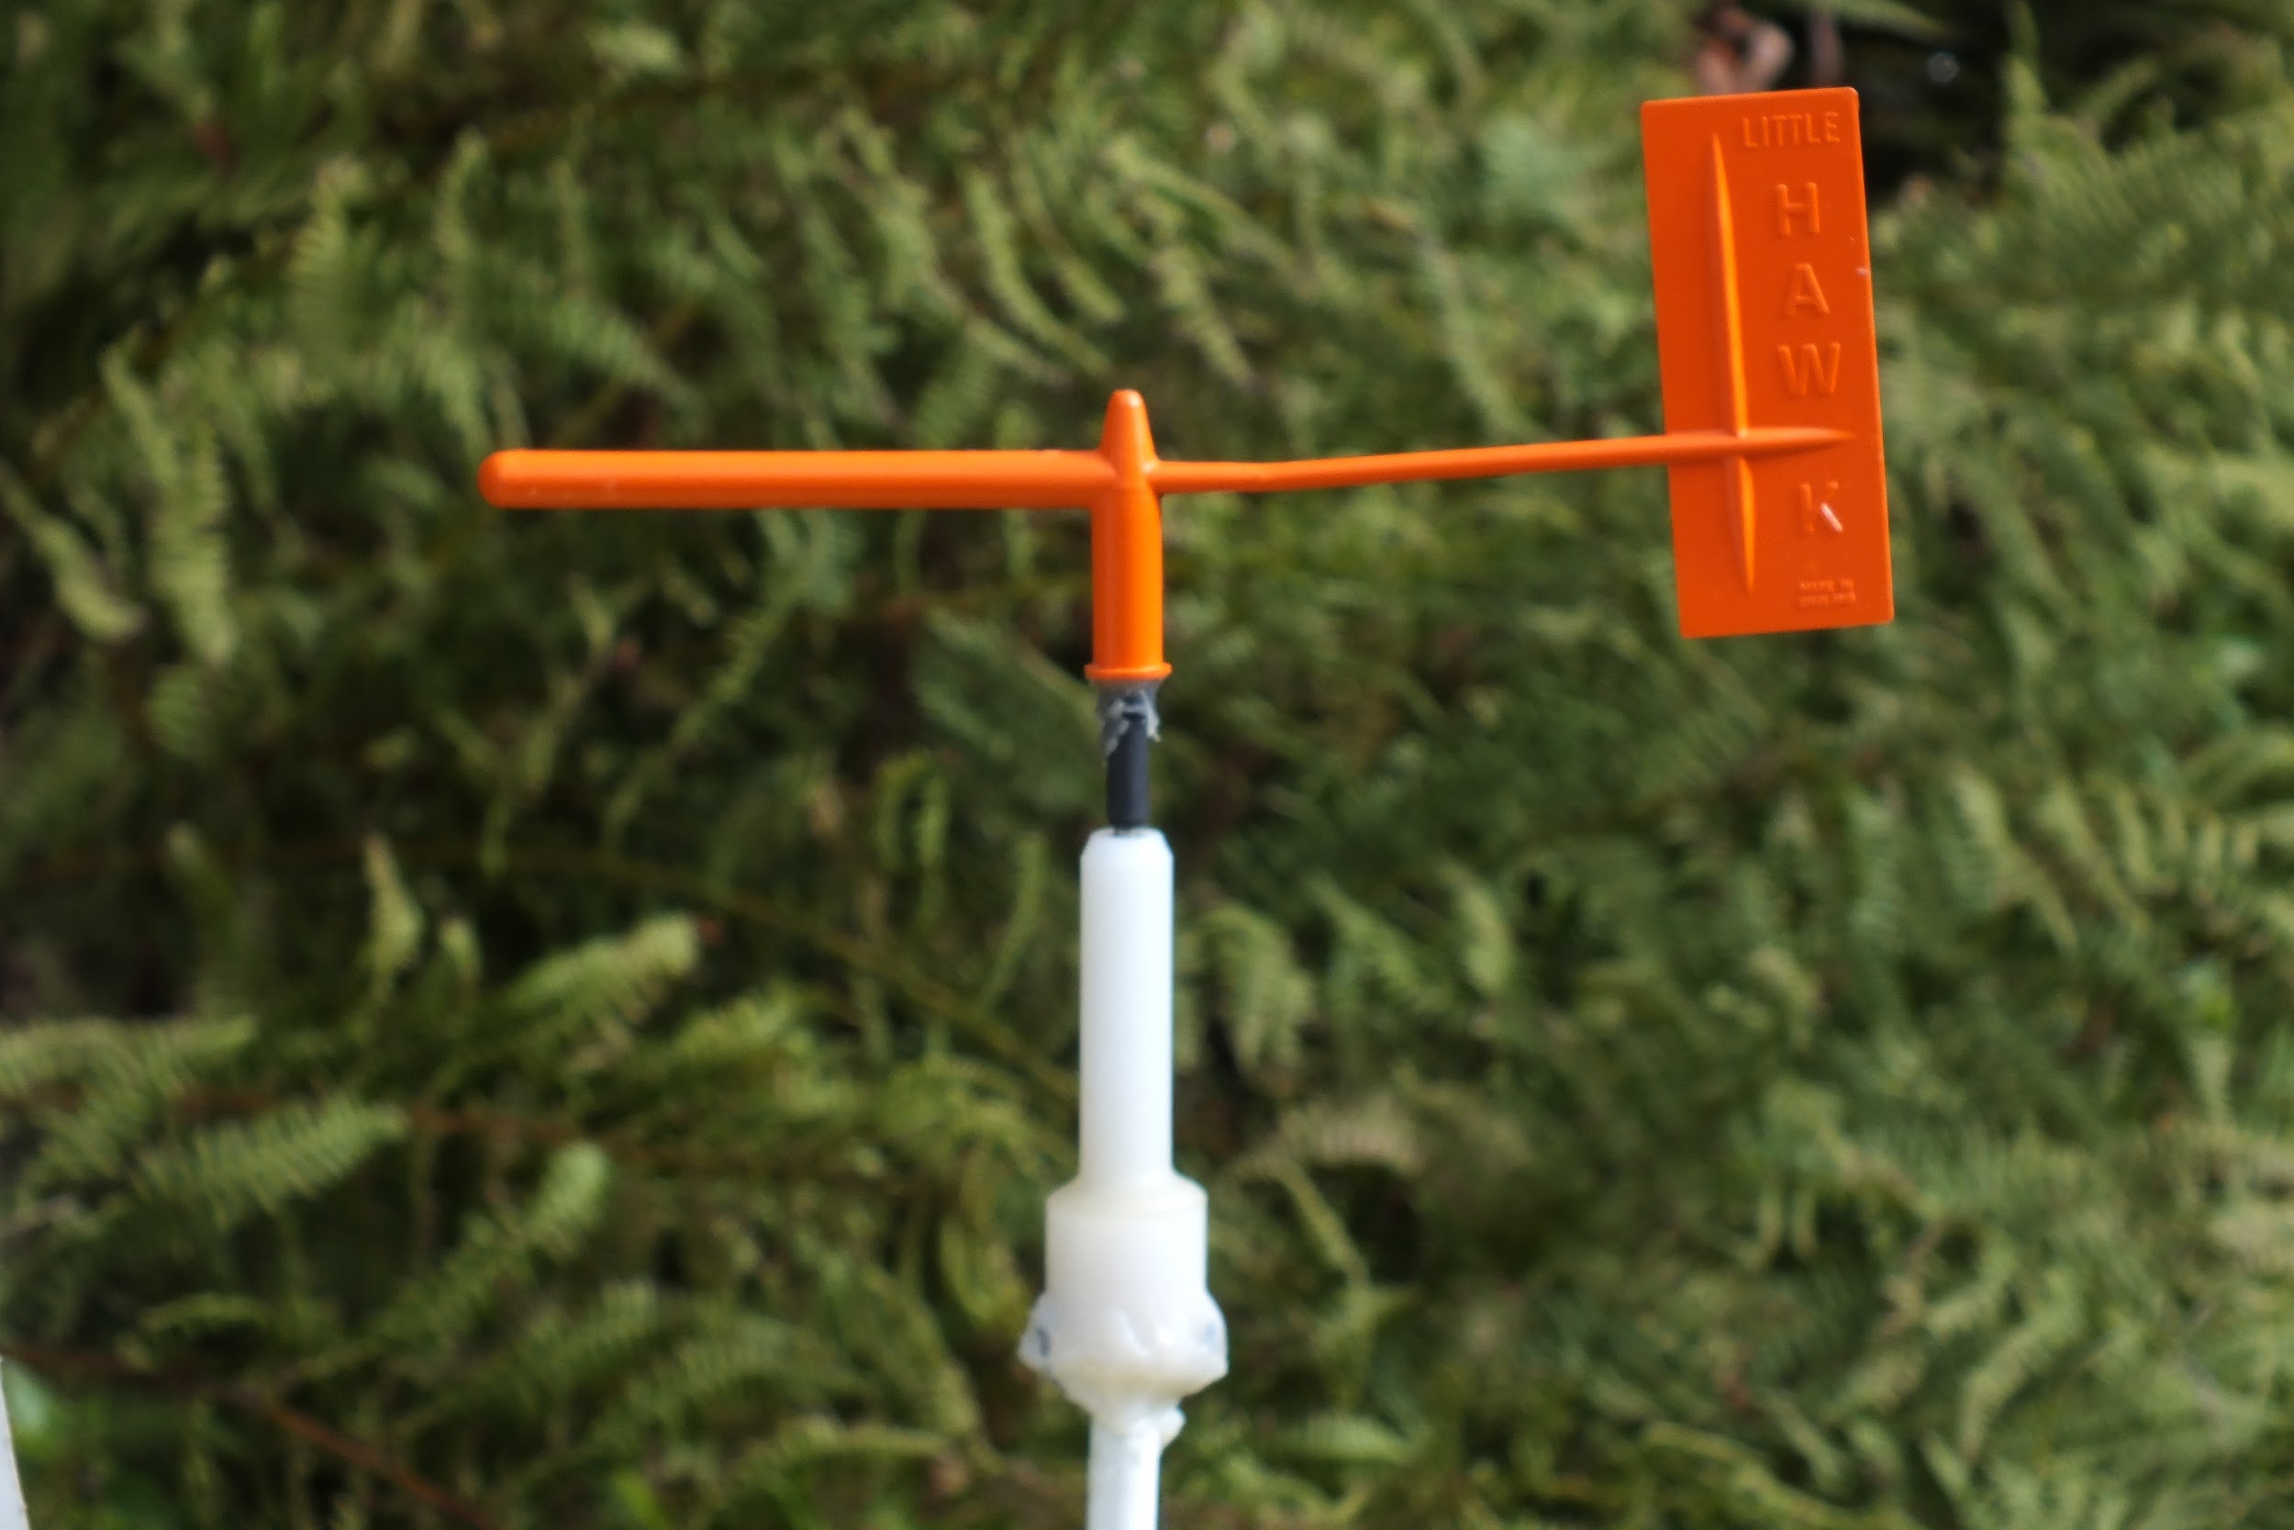
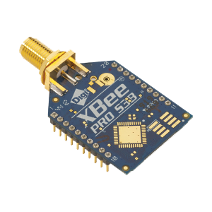
Electronics
RaspberryPi and Arduino
Captain Morgan PCB
Wind Sensor
Compass
fb.com/abersailbot @abersailbot sailbot@aber.ac.uk
Notes:
RaspberryPi
Python
WiFi Access
Arduino
More maintainable and reliable, tidy
PCB - Captain H. Morgan
Wind Sensor - Designed by dept
Was Messy

Slide 9
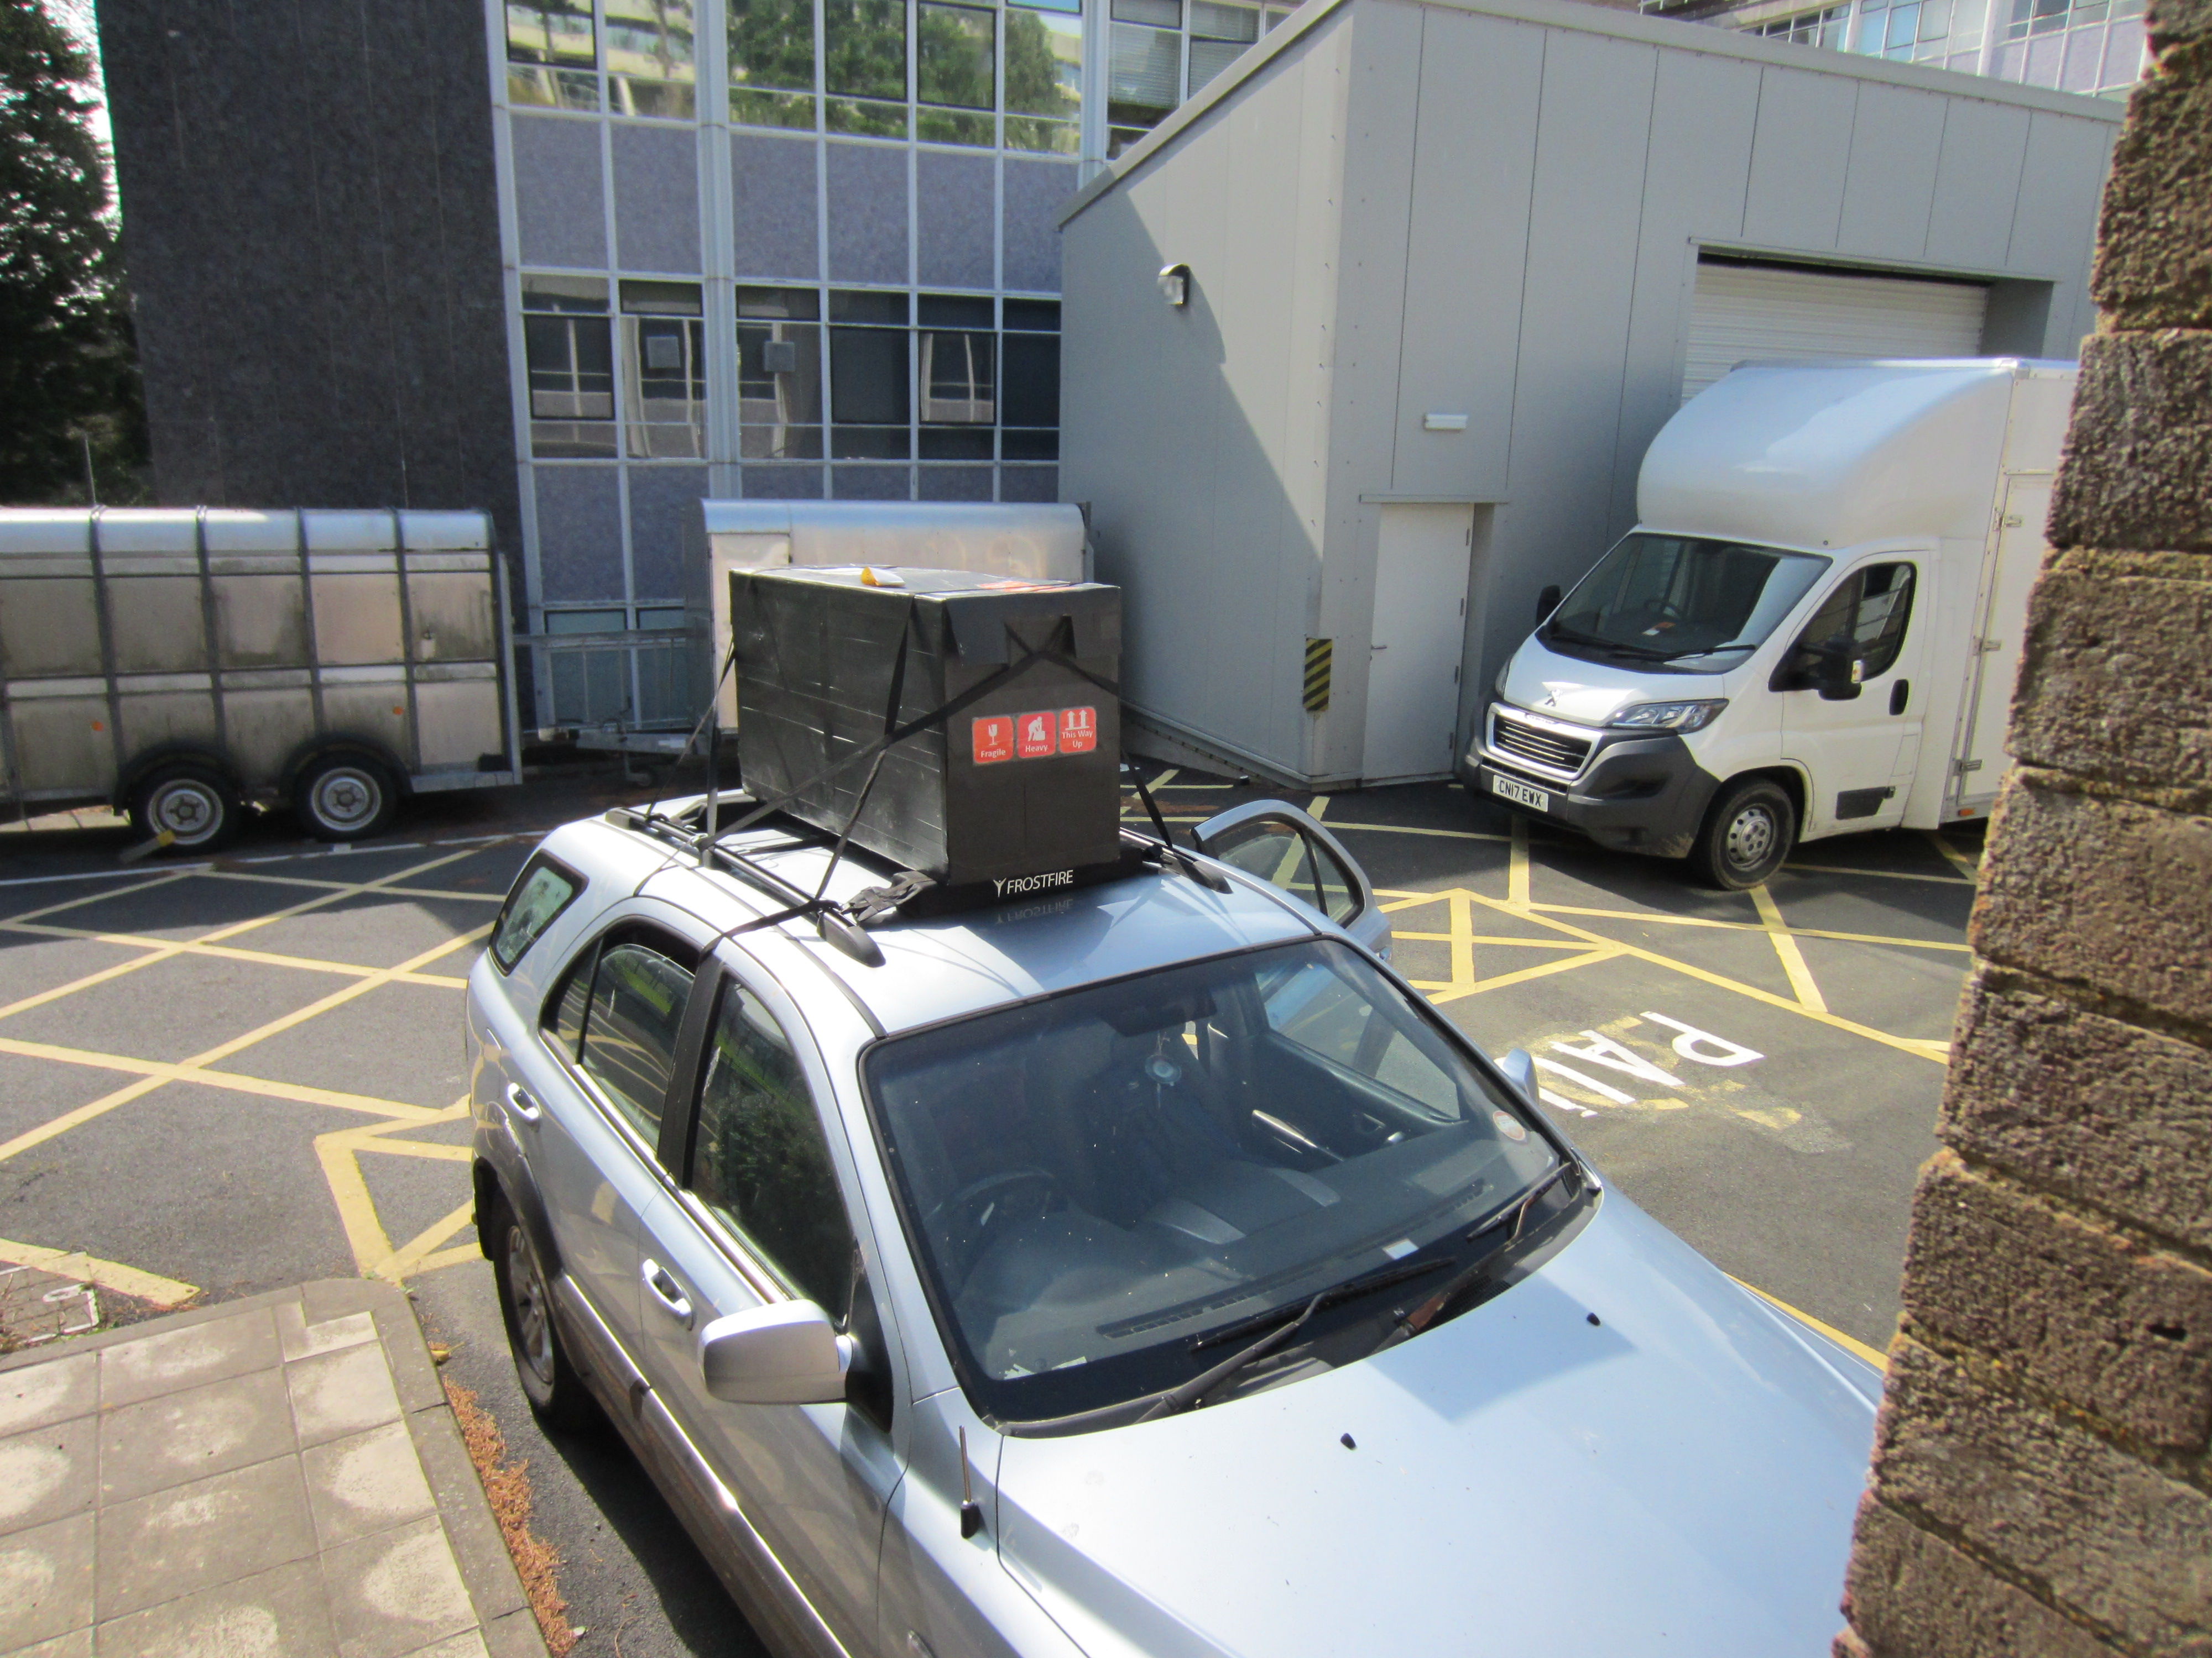
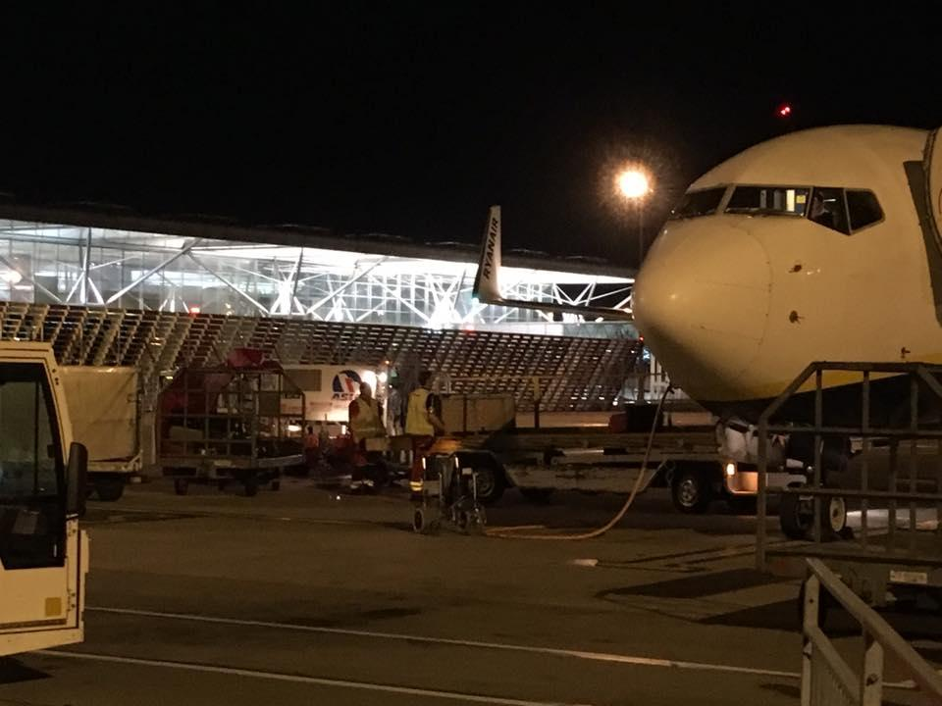
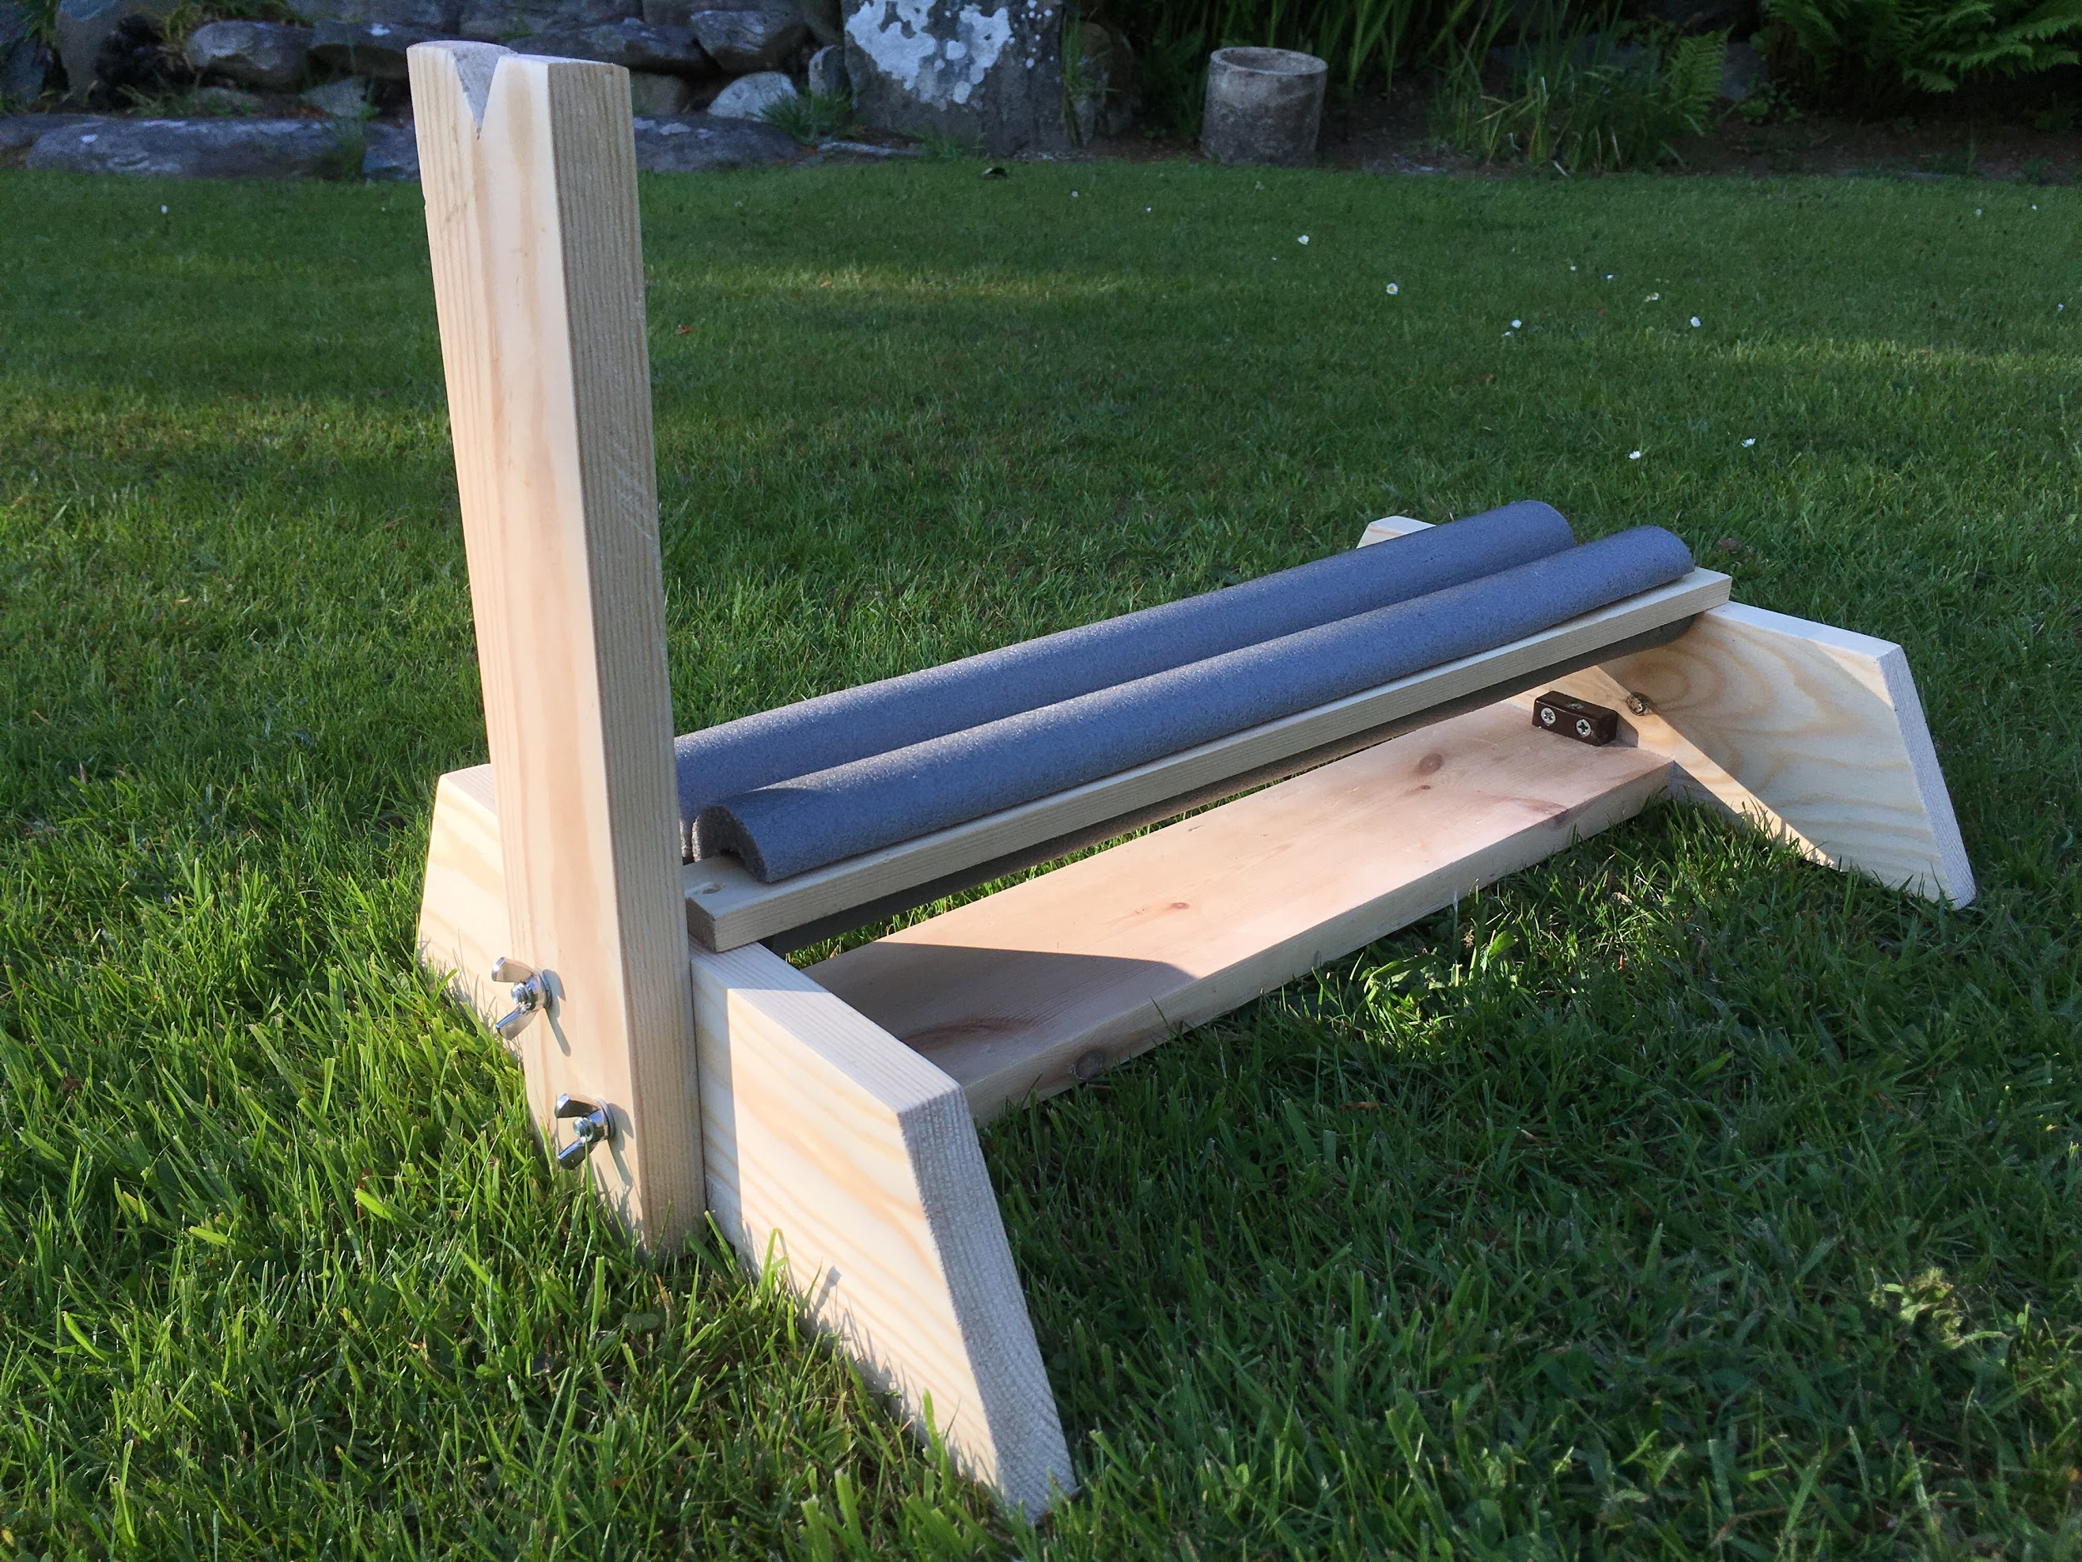
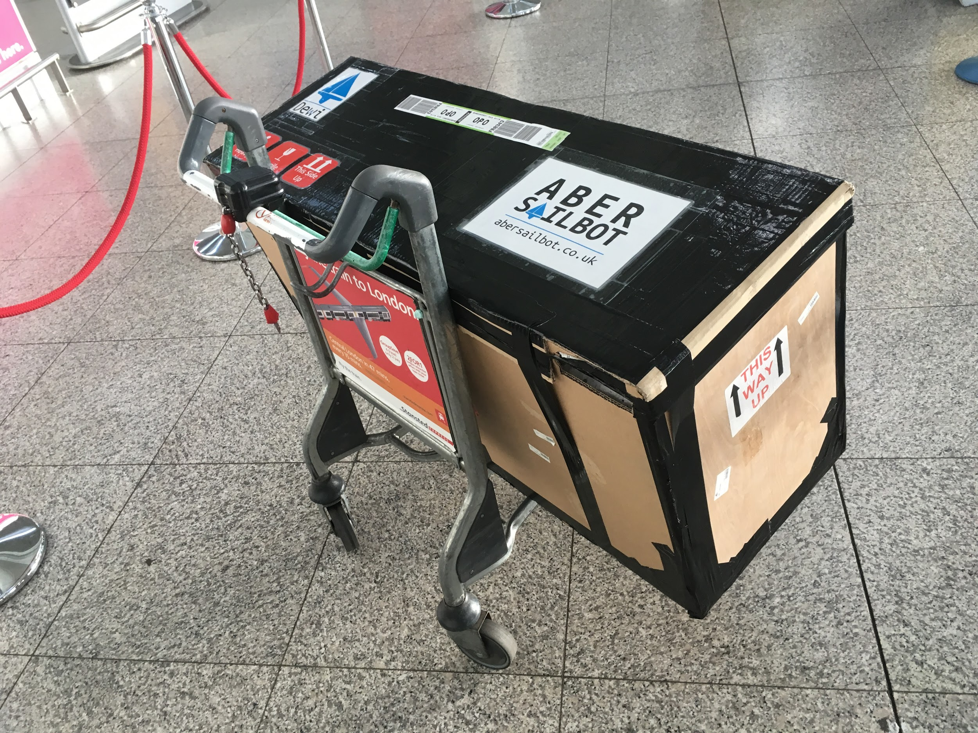
Transport
fb.com/abersailbot @abersailbot sailbot@aber.ac.uk
Notes:
Old Box & New Replacement
Transporting to Canada
Replacement stand

Slide 10

Competitions - Sailbot
SailBot
Student focused
Emphasis on boat design
Usually in USA or Canada
June 7th-12 2020:
Amesbury, (near Boston)
Massachusetts, USA
fb.com/abersailbot @abersailbot sailbot@aber.ac.uk
Notes:
International Robotic Sailing Regatta (known as Sailbot)
Annual - North America
University teams
RC and Autonomous

Slide 11

Competitions - WRSC
World Robotic Sailing Championships
More research focused
Emphasis on autonomy
Collision Avoidance
Station Keeping
Area scanning
We might host 2020
fb.com/abersailbot @abersailbot sailbot@aber.ac.uk
Notes:
International Robotic Sailing Regatta (known as Sailbot)
Annual - North America
University teams
RC and Autonomous

Slide 12
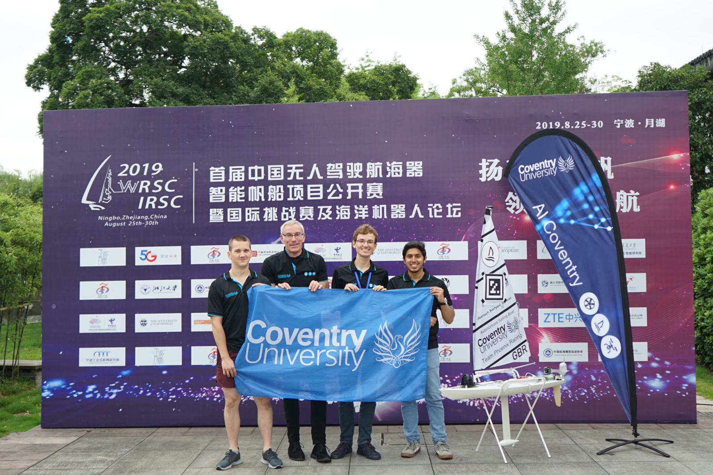
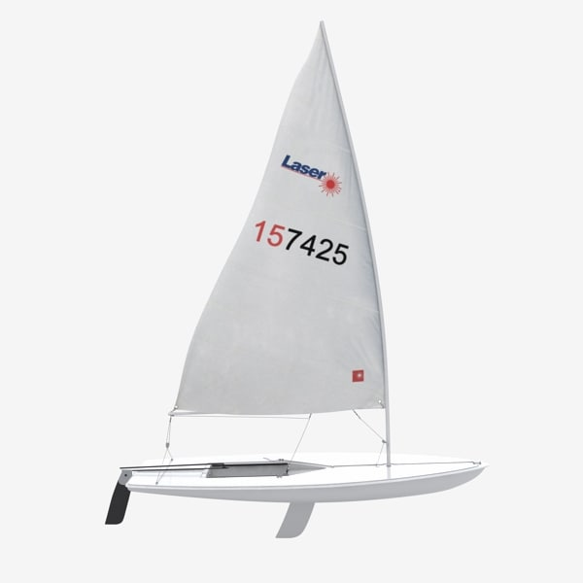
Competitions - Robosail
RoboSail
RC Laser Hulls
Everyone uses same boat
Åland Islands, Finland sometime in May
fb.com/abersailbot @abersailbot sailbot@aber.ac.uk
Notes:
International Robotic Sailing Regatta (known as Sailbot)
Annual - North America
University teams
RC and Autonomous

Slide 13
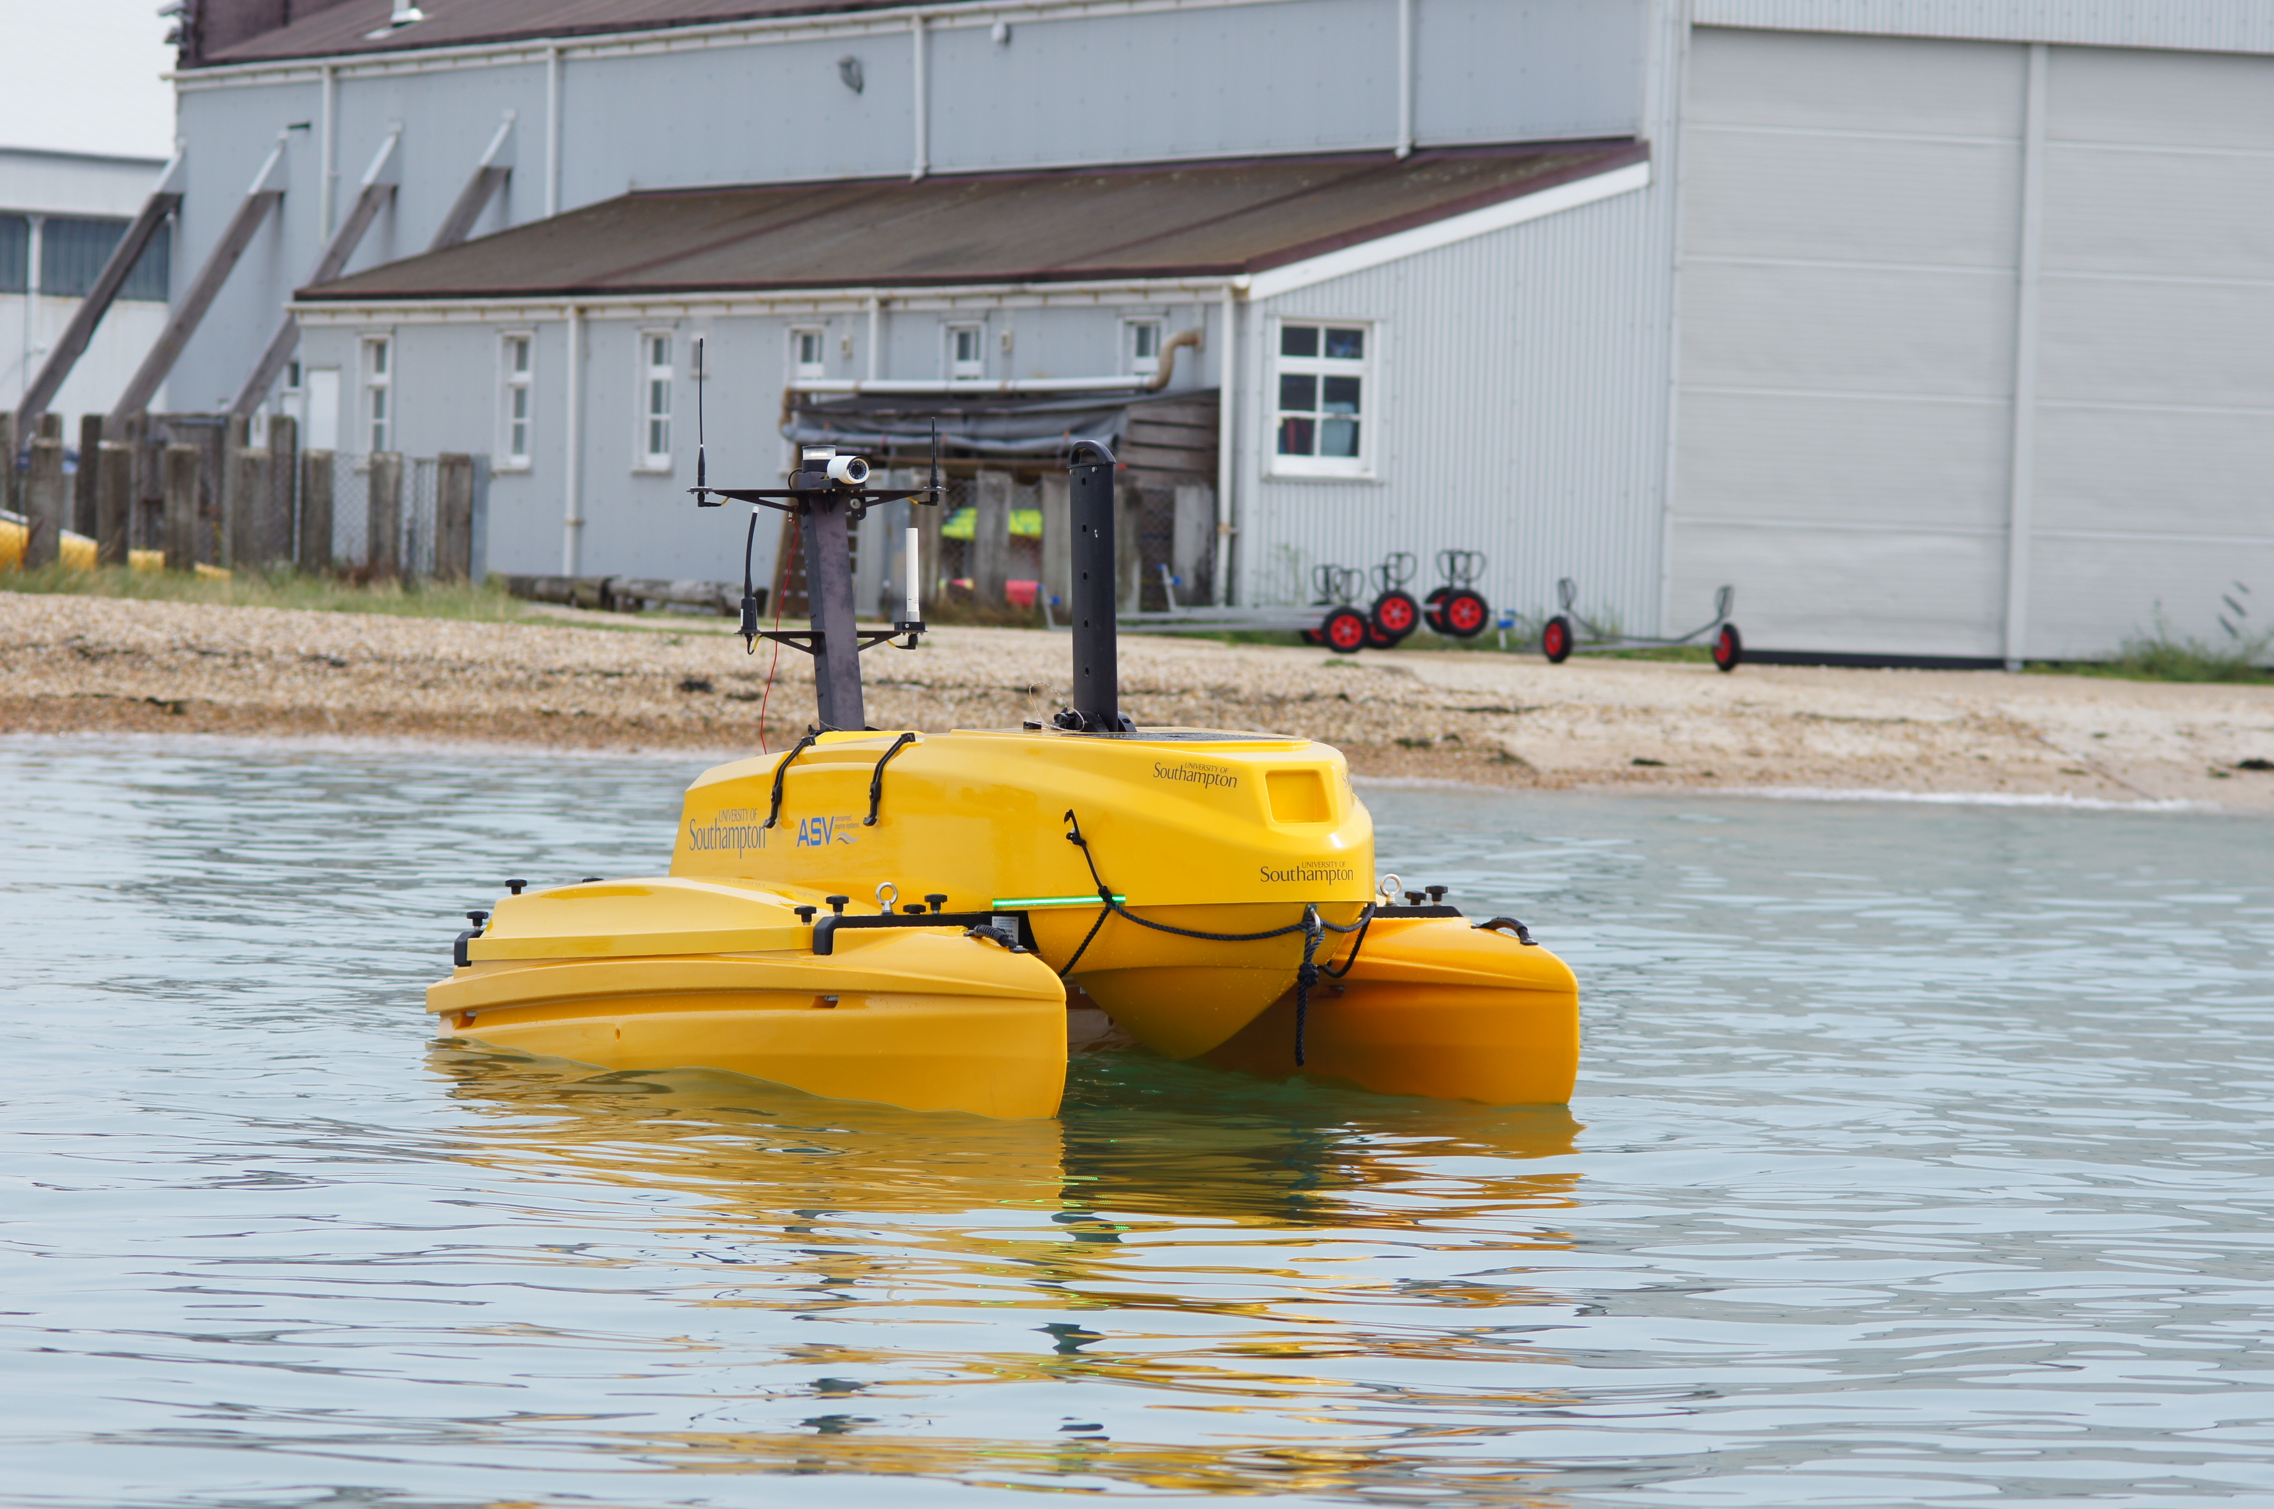
Competitions – Marine Autonomy Challenge
Motorboat Competition
Sponsored by L3 ASV
Open to UK Universities
Locate “litter” in the water
Teams given hull and motors
Was supposed to be August last year, cancelled in June
fb.com/abersailbot @abersailbot sailbot@aber.ac.uk
Notes:
International Robotic Sailing Regatta (known as Sailbot)
Annual - North America
University teams
RC and Autonomous

Slide 14
Plan for this year
RC laser competition – Mid November
Weekly theoretical/skills sessions
Fix Kitty, Improve Dewi
New boat?
Visit Coventry Uni, go to a Raspberry Jam
Go to all the competitions: RoboSail, Sailbot, MAChallenge, WRSC
fb.com/abersailbot @abersailbot sailbot@aber.ac.uk
Notes:
Robotic Boats
RC and Sail Themselves
Code (boatd etc)
Competitions
Microtransat
Not alone - community of people

Slide 15
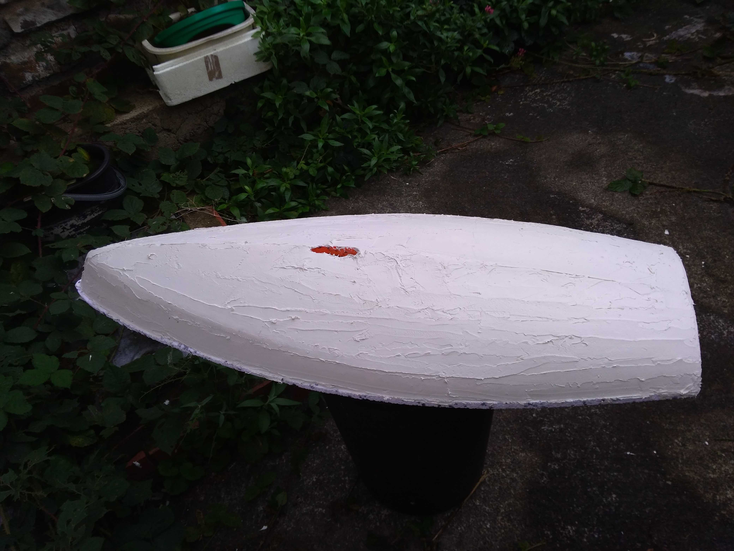
Mini RC Laser competition
Teams of 4 or 5 people
Polystyrene RC laser hull
Raspberry Pi computer
Captain Morgan board
Standard AberSailbot software
Race November 16th/17th
fb.com/abersailbot @abersailbot sailbot@aber.ac.uk
Notes:
Robotic Boats
RC and Sail Themselves
Code (boatd etc)
Competitions
Microtransat
Not alone - community of people

Slide 16
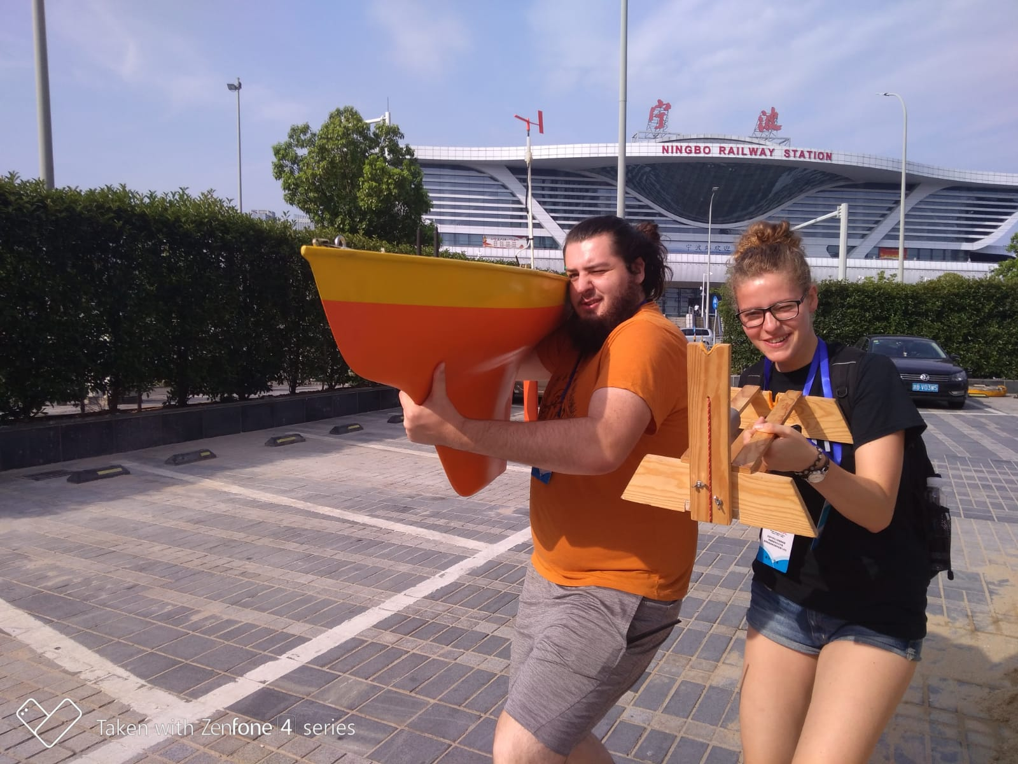
Thanks for Listening!
Tell us when you’re available:
https://tinyurl.com/abersailbot-times
Join our mailing list and Slack:
https://abersailbot.co.uk/joinus
fb.com/abersailbot @abersailbot sailbot@aber.ac.uk
Notes:
Fill form (abersailbot.co.uk/joinus)
Give us email in ThinkTank
Facebook Message, Tweet, Email

